Slide 1
making a great place even better
troon Community Council
in partnership with
Troon Development Trust
Vision
Troon
2030
July 2024
New Dawn Rising - the view from Barassie Bank, Troon
by working better together

Slide 2
Introduction
Troon Community Council and Troon Development Trust are putting this document forward for public and stakeholder comment.
This is our attempt at revitalising the original Troon Together Action Plan, breathing new life into an updated vision and ambition for the town.
It reflects the aspirations and ideas identified by Troon residents, students, business owners and local organisations who contributed to the original plan in 2020 - presented and approached in a new way.
We hope you find it useful and inspiring and that it encourages you to get involved.
We would like your views, and most importantly, telling us what still matters to you and how you would like to get involved and contribute.
Please do send us your comments using any of the following:
Facebook : Troon Community Council
: Troon Development Trust
Vision
Troon
2030
July 2024

Slide 3
How Troon ranked in 2023/2024
2030
AMBITION
Troon is widely recognised as a vibrant and lively town with something for everyone
and
is regularly listed as one of the best places to
live, work,
start a business, visit and play
Troon
not listed
Troon
not listed
Vision
Troon
2030
Troon
not listed
Largs is listed
Troon
not listed
AYR & GIRVAN LISTED
July 2024
Troon
not listed
Saltcoats & Millport listed

Slide 4
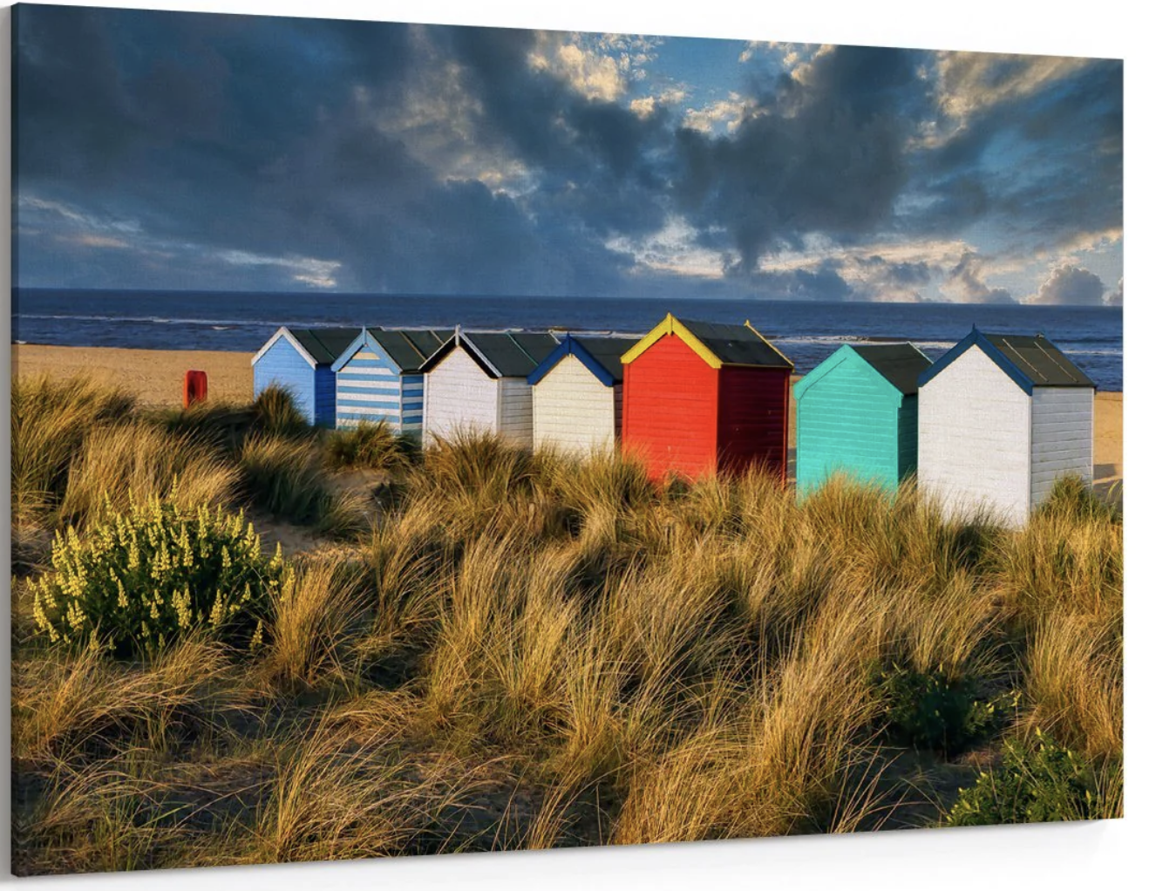
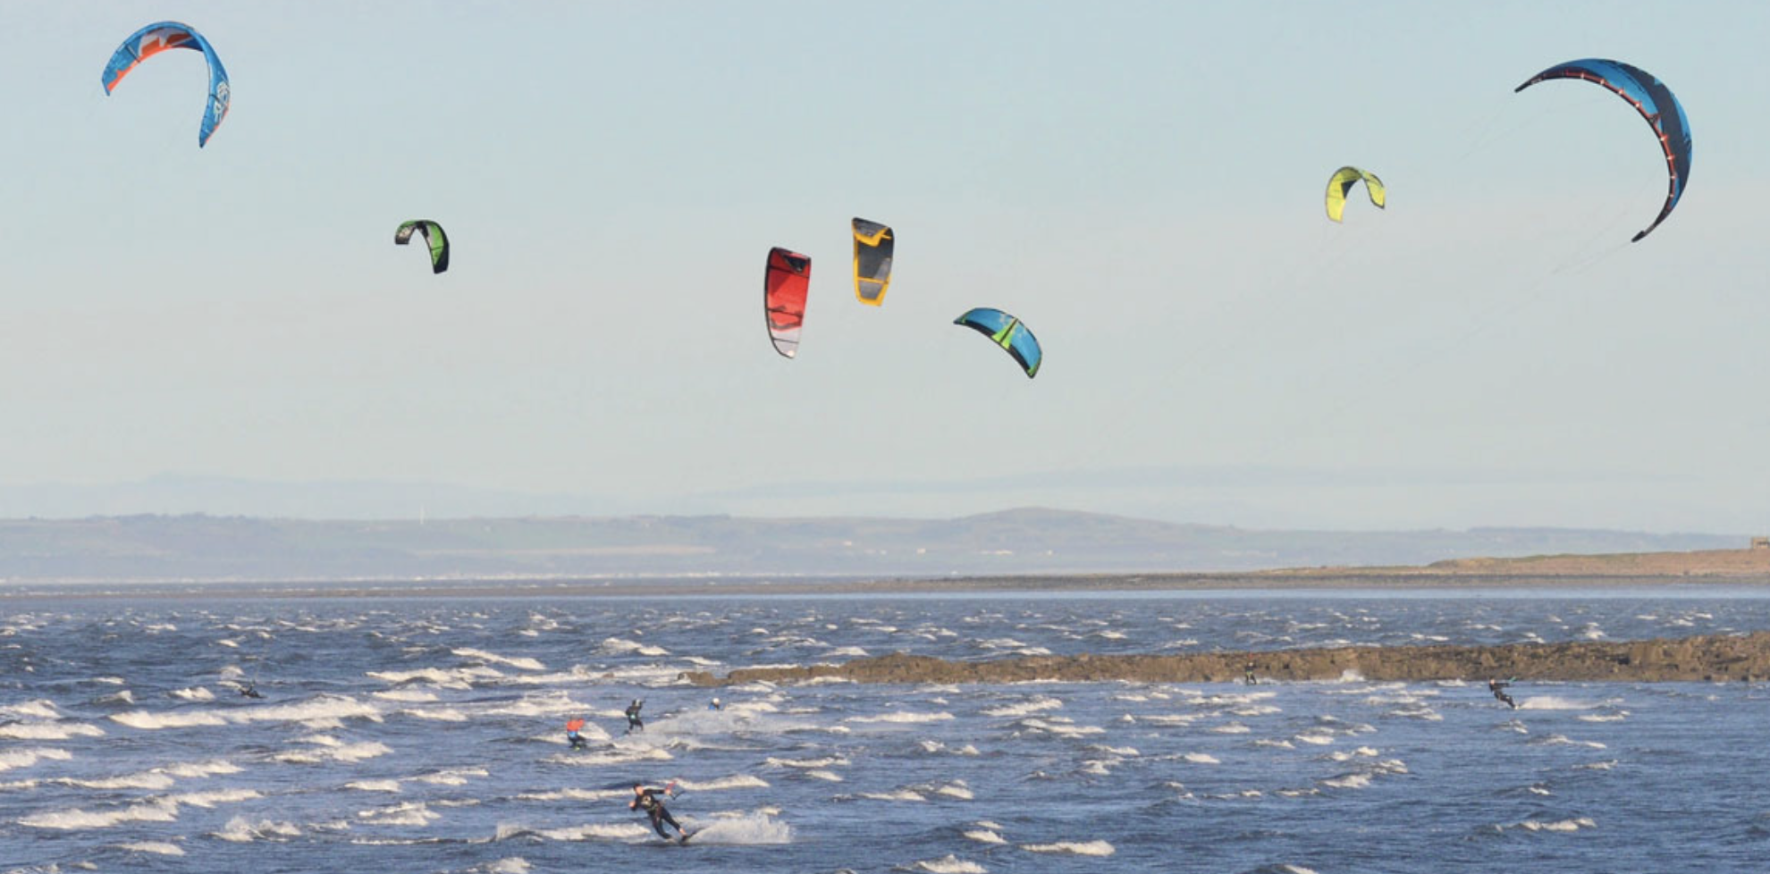
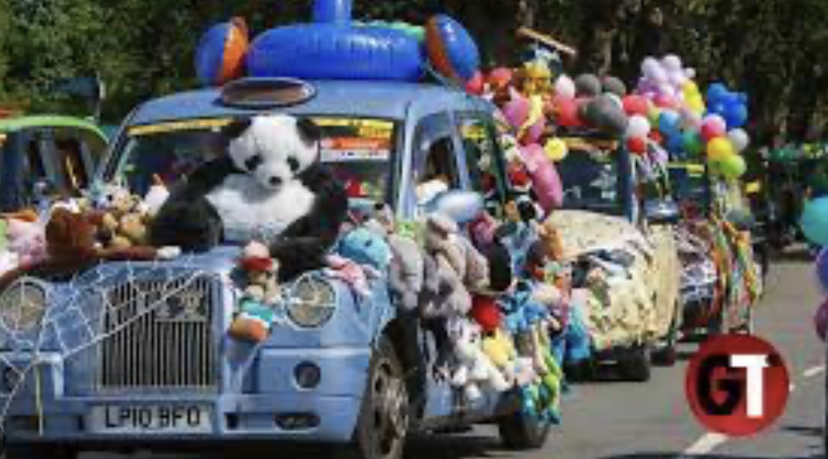
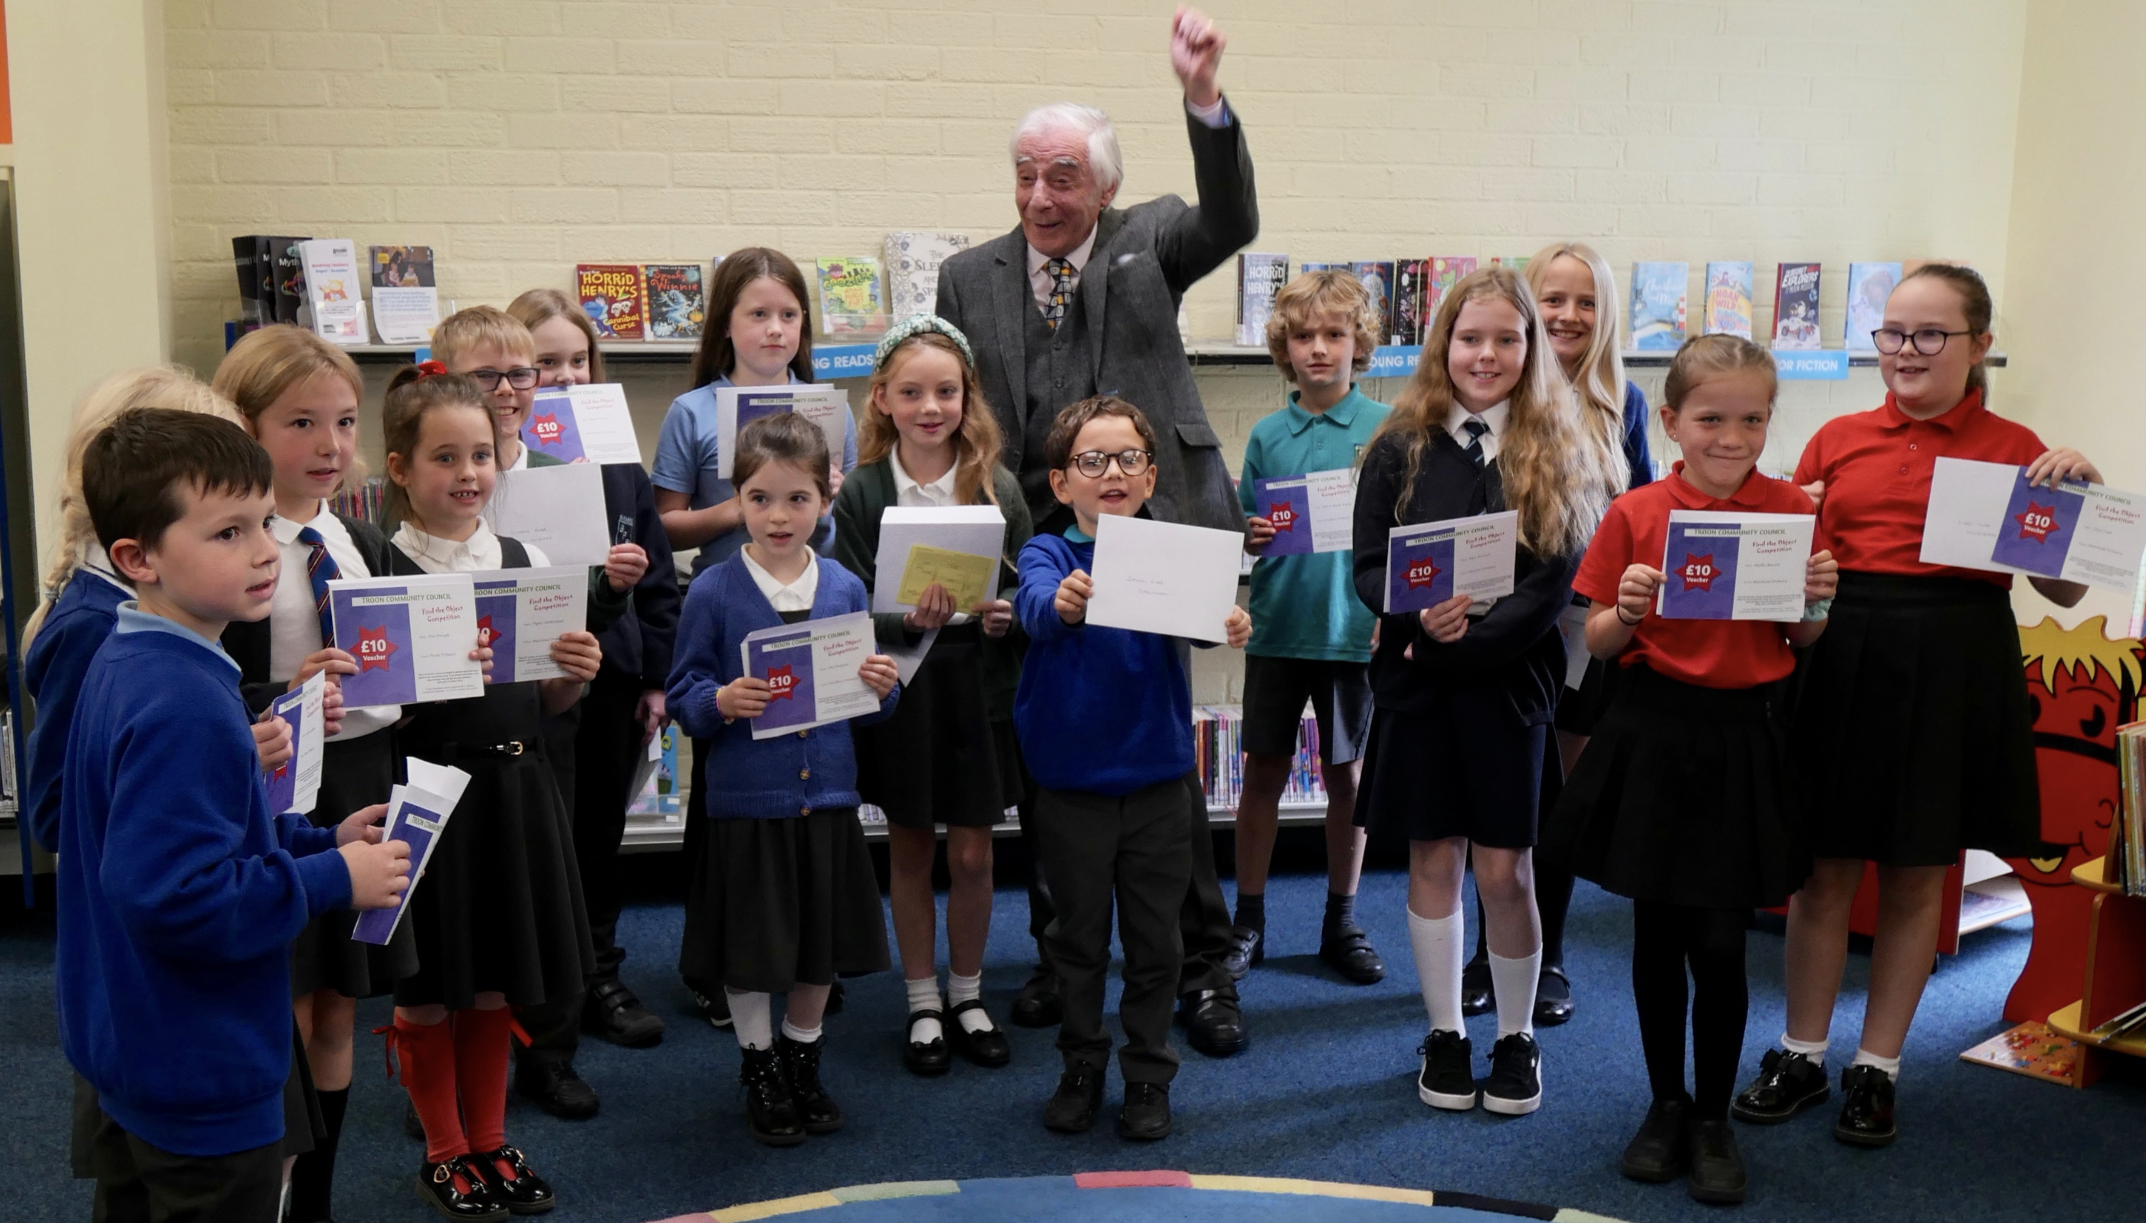
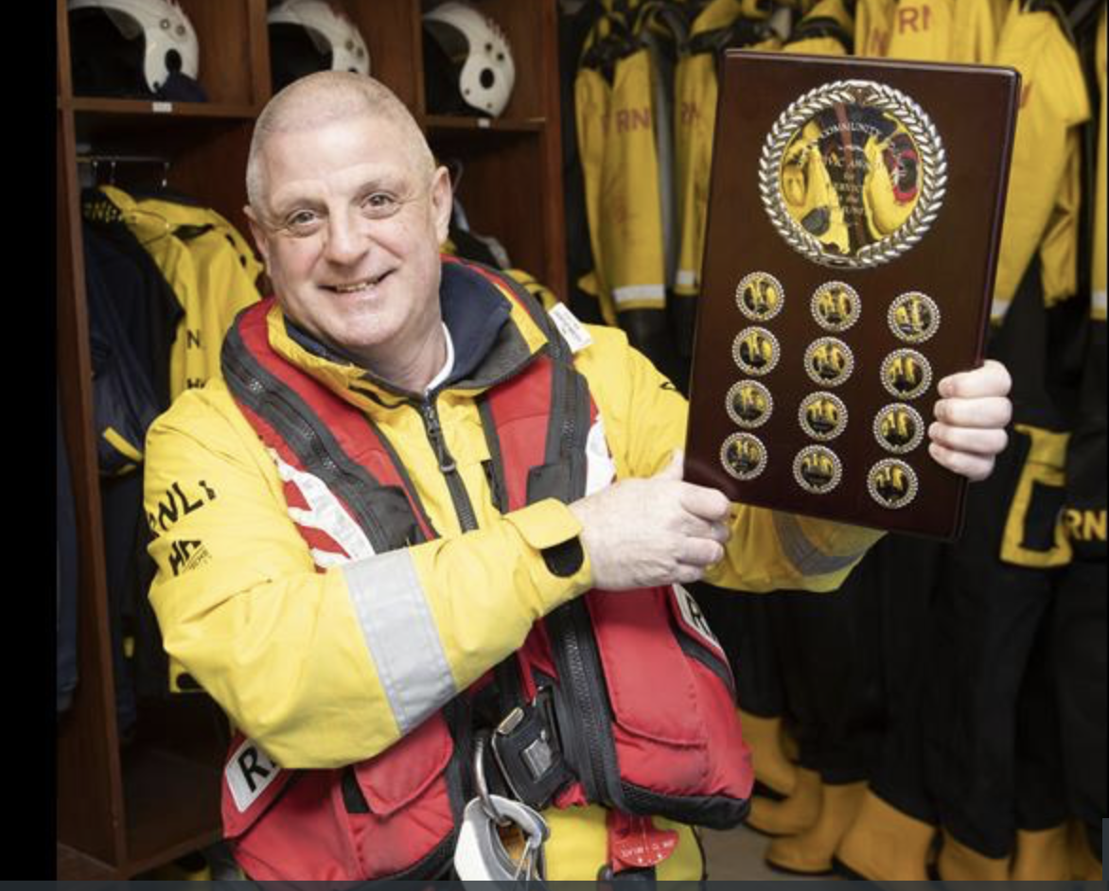
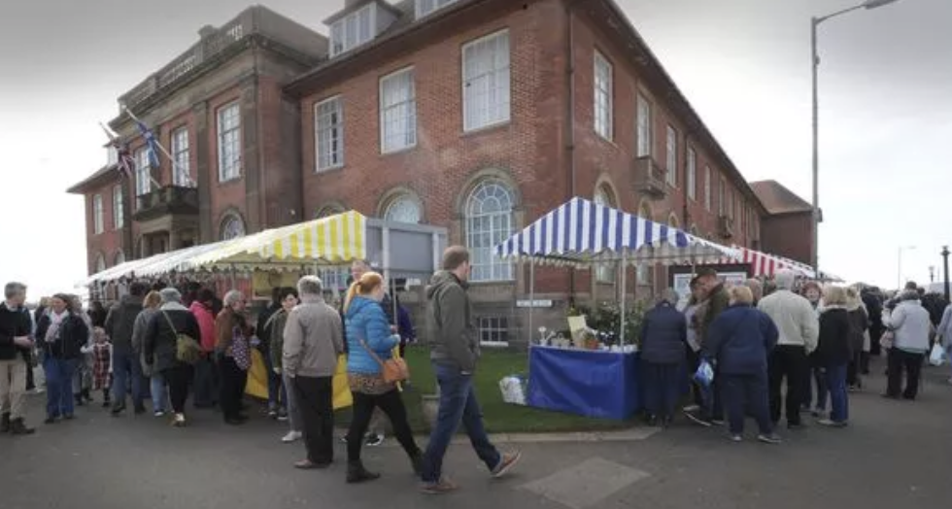
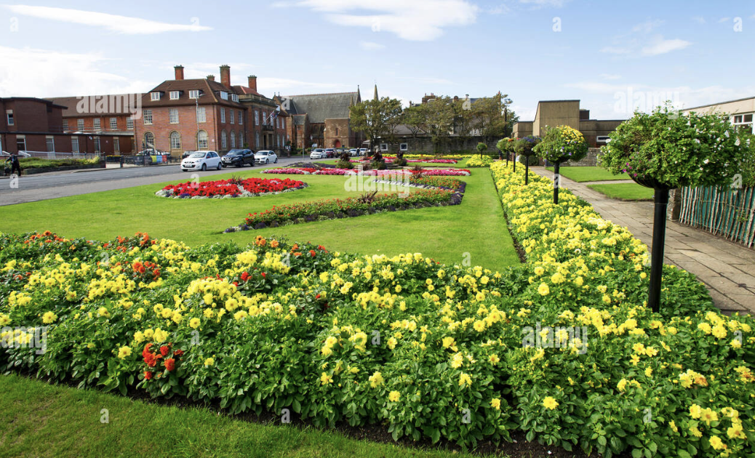
Vibrant
colourful, energetic and lively
Communities
engaged, active, safe and proud
Vision
Troon
2030
Thriving
growing, blooming and prospering
July 2024
Together
connecting, collaborating and creating
The brightest jewel in the Ayrshire crown
T
R
O
O
N

Slide 5
making a great place even better
SAC Thriving Places
Troon Development Trust
SAC Economic Development
Connecting – Collaborating - Creating
Troon Community Council
Working
together
SAC Thriving Communities
Troon Youth Council
Powerful Partnerships
SAC Ward Councillors
Troon Business Networks
3rd Sector Organisations
Troon Residents Associations
Community Groups, Associations, Clubs, Charities, Churches, Volunteers
5 key themes
Vision Troon 2030

Slide 6
The people of Troon identified 5 key themes towards creating
a more vibrant and thriving town
Theme 1: Town & Seafront enhancement and local economy development
Town regeneration
Seafront transformation
Encouraging more visitors
creating an arts, culture & heritage community, facilities, events & landscape
Developing business networks
Promoting local businesses
Theme 2 : Infrastructure & services
Improved traffic management
Improved active travel
Improved access to towns & services
Theme 3: Recreation & culture
Enhanced Sporting activities
Interesting & engaging young person events & activities
Promoting improved health & wellbeing
Establishing & promoting new events dedicated to arts & culture
Theme 4: Environment & heritage
Improved environmental sustainability
Developing woodlands and walks
Promoting, appreciating & celebrating the town’s rich heritage & history
Theme 5: Youth Community
Developing youth focused initiatives
Developing neighbourhood networks
Enabling the voice of the younger community to be heard
Vision
Troon
2030
July 2024

Slide 7
VISION TROON - 2030 GOAL
Troon has a vibrant, colourful, creative town centre and seafront with thriving businesses and events
The brightest jewel in the Ayrshire crown
What would it take to achieve?
T
R
O
O
N
2024 | 2025 | 2026 | 2027 | 2028 | 2029 | 2030
Creating a visual brand for Troon that represents our vision
Creating a more colourful town centre and seascape and areas of interest
Creating better signage and points of interest
Increasing utilisation & effectiveness of existing community spaces
Creating new community hubs, civic spaces and events
Increasing utilisation of empty shop spaces
Creating better marketing and promotion of what Troon has and what’s happening
It will require teams to focus on different areas, working with partners and experts, with appropriate funding where required,
and the community to evaluate ideas and options and then deliver solutions

Slide 8
VISION TROON - 2030 GOAL
our community, partners and stakeholders have been instrumental in shaping & creating Troon’s future across a wide range of projects
What would it take to achieve?
2024 | 2025 | 2026 | 2027 | 2028 | 2029 | 2030
SAC Thriving Communities, Places, and economic development team are key partners in implementing change and positive impact
Residents and businesses and community groups are closely involved in determining local solutions
An enthusiastic community of volunteers are helping drive improvements across many areas
Local businesses are key providers of expertise and support in shaping the future
It will require teams to focus on different areas, working with partners and experts, with appropriate funding where required,
and the community to evaluate ideas and options and then deliver solutions

Slide 9
VISION TROON - 2030 GOAL
Troon has a wider variety of sporting, cultural, music, artistic, civic spaces and interests for all ages
SPORTS, ART AND CULTURE FOR ALL
What would it take to achieve?
T
R
O
O
N
2024 | 2025 | 2026 | 2027 | 2028 | 2029 | 2030
The Troon calendar of sporting, civic, music, business and cultural events is widely known and easily available to all
SAC Destination Ayrshire and other partners are key players in developing and promoting new spaces and events
An enthusiastic community of volunteers and groups are helping to create new spaces, areas of interest and new events
A new dedicated community space – for showcasing and celebrating Arts, Culture & History – is rapidly becoming a great new asset to the town
It will require teams to focus on different areas, working with partners and experts, with appropriate funding where required,
and the community to evaluate ideas and options and then deliver solutions

Slide 10
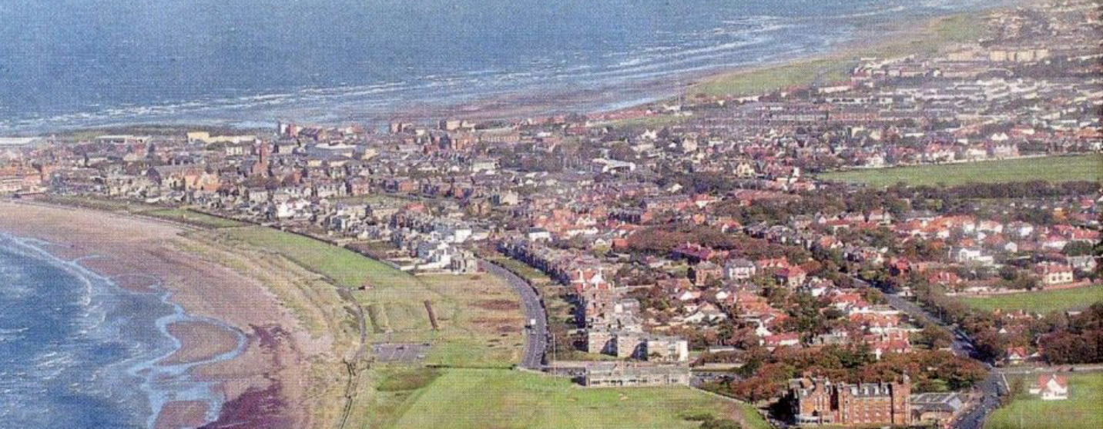
VISION TROON - 2030 GOAL
Troon is a clean, eco-friendly town with many attractive green spaces and easy access for all
Getting around Troon Town
What would it take to achieve?
2024 | 2025 | 2026 | 2027 | 2028 | 2029 | 2030
Creating better, easier flow of traffic and people throughout the town and surrounds
A master plan and strategy for improving green spaces, the coastline and each of the beachfronts, North, South, Ballast Bank – recognising unique characteristics and potential of each
It will require teams to focus on different areas, working with partners and experts, with appropriate funding where required,
and the community to evaluate ideas and options and then deliver solutions

Slide 11
VISION TROON - 2030 GOAL
The young people of troon express positive attitudes about what they can do, where they can go and the opportunities available to them – and they now rate troon as a great place to stay
What would it take to achieve?
“Living in Troon is like being at a great party – we don’t want to leave early”
2024 | 2025 | 2026 | 2027 | 2028 | 2029 | 2030
The Troon Youth Community Council are established and functioning as a highly effective group representing the voice of their community
Initiatives designed specifically for younger people are identified and implemented
A community of volunteers across all ages – working together with SAC and other third-sector organisations – are designing and delivering initiatives specifically targeted at the needs and interests of the younger generation within our community
It will require teams to focus on different areas, working with partners and experts, with appropriate funding where required,
and the community to evaluate ideas and options and then deliver solutions

Slide 12
making a great place even better
SAC Thriving Places
Troon Development Trust
SAC Economic Development
Connecting – Collaborating - Creating
Troon Community Council
Working
together
SAC Thriving Communities
Troon Youth Council
Powerful Partnerships
SAC Ward Councillors
Troon Business Networks
3rd Sector Organisations
Troon Residents Associations
Community Groups, Associations, Clubs, Charities, Churches, Volunteers
Vision Troon 2030
troon Community Council & Troon Development Trust

